Slide 1


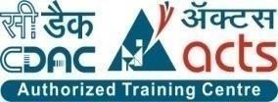
E-RTO System
Presented By:-
Group No: 12
Aniket Jain (219021)
Sidak Bhatia (219193)

Slide 2
Points to be discussed:-
Introduction
Motivation
Objectives
Technology Used
UML Diagrams
Screenshots
Specification
S/W and H/W Requirements
Advantages
Conclusion
Future Scope
Reference's

Slide 3
INTRODUCTION
The e-RTO System's aim is to automate the major processes in Regional Transport Offices. The Online RTO system provides citizens with 24/7 access to services like online registration for Learner's license & Permanent license. Admin can update application status and can also manage time slots for tests. The main motive of the system is to make the daily activities efficient and to provide fast response by storing and retrieving information & informing it to the users via Email.

Slide 4
MOTIVATION
Now a day’s many people are purchasing two wheelers, four wheelers etc. So the RTO employees having lot of work burden of making registration. License issue, transfer etc. which required lot of paper work. As a result people cannot get the things done in right time, which waste the time, energy. So to overcome these drawbacks we are developing an enhanced e-RTO Management System. Such like that we provide one type of environment which gives a user friendly means user can access and understand well. Administrator has the power to verify the data entered by the user, processing of data and provide appropriate solutions.
E-RTO Management system is an advanced system which is designed keeping in view to make the existing registration system easier and faster. It includes the entire registration procedure starting from the initial phase of entering till the results. It is more reliable, accurate time, saving and free from any misuse. The tedious jobs such as verifying all the records of the applicant, confirming all the personal details are furnished, submission of documents, driving license, registration details, etc. are
done in the most convenient way to the administrator. Also security is being provided in the most proficient way.

Slide 5
OBJECTIVE
The aim is to build a user-friendly webpage where the citizens can apply for learner’s license, driving license. The webpage also provides provision for citizens to submit their complaints. Mainly, the website is used for issuing of license. An individual can apply for learning license and driving license online. Accordingly, slots and dates are generated for the respective test. The application received will be verified and approved by the RTO officials. The applicant can monitor the status of their application.

Slide 6
Technology Used:-
Front End: React Js
Back End: Java Spring Boot API.
Back-end database: MySQL

Slide 7
UML DAIGRAMS

Slide 8
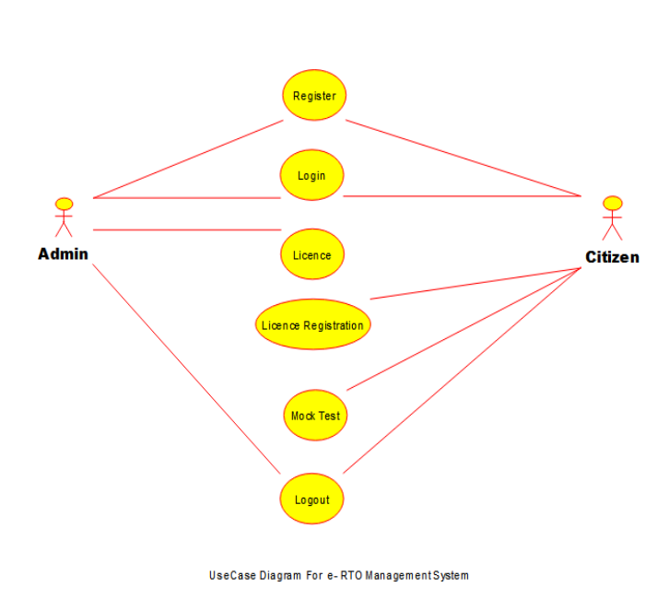
UseCase Diagram

Slide 9
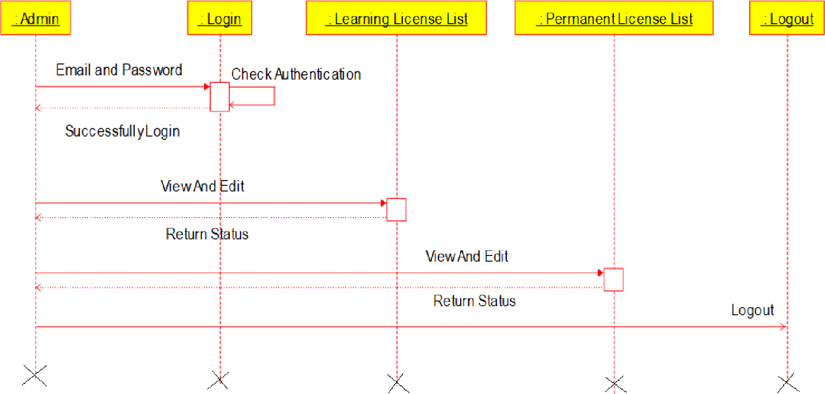
Admin’s Sequence Diagram

Slide 10
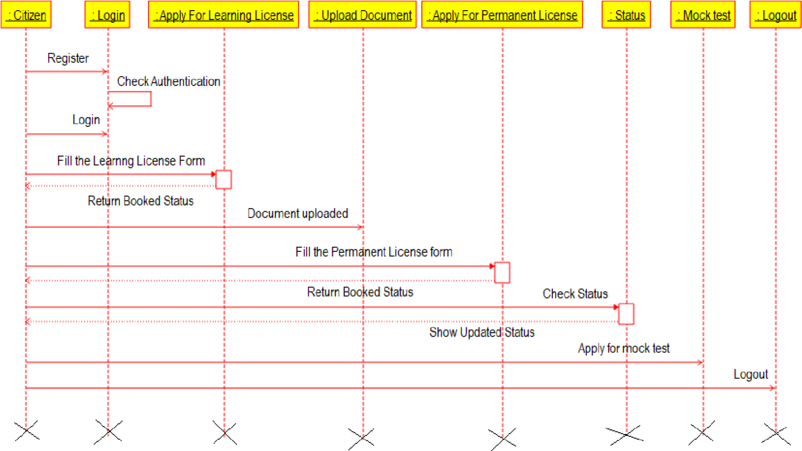
Citizen Sequence Diagram

Slide 11
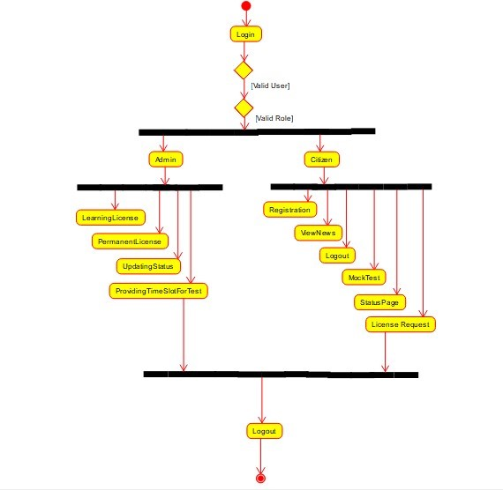
Activity Diagram

Slide 12
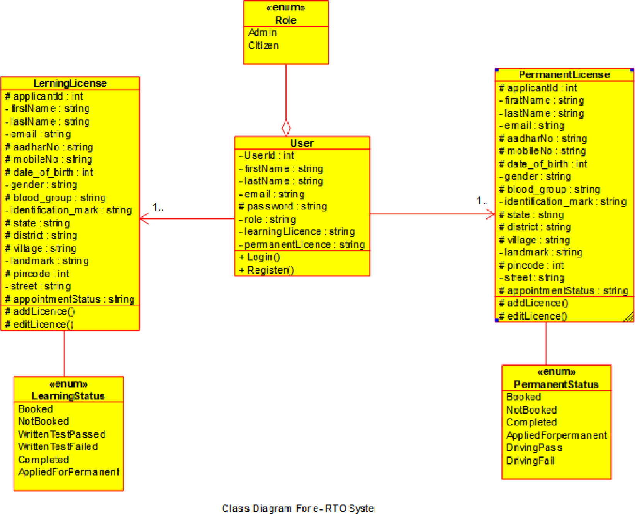
Class Diagram

Slide 13
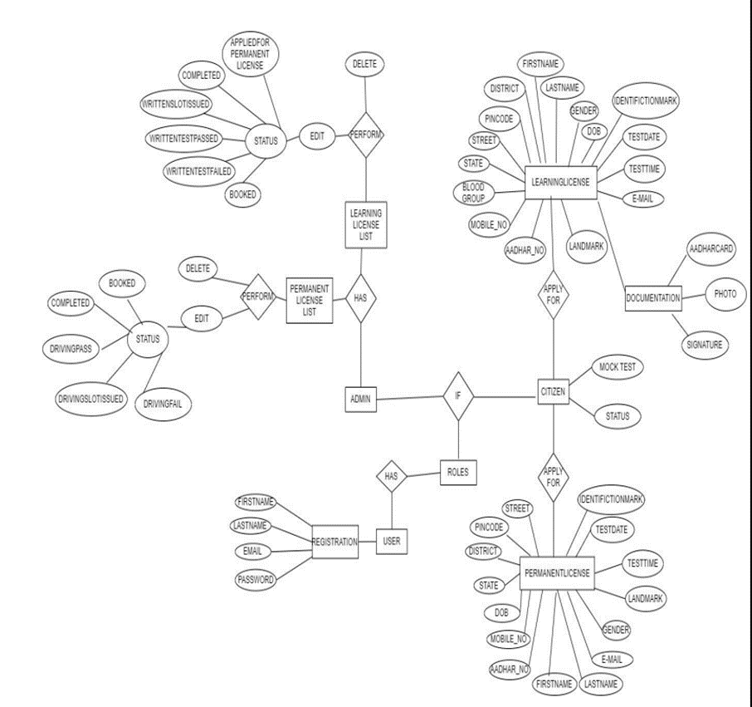
ER Diagram

Slide 14
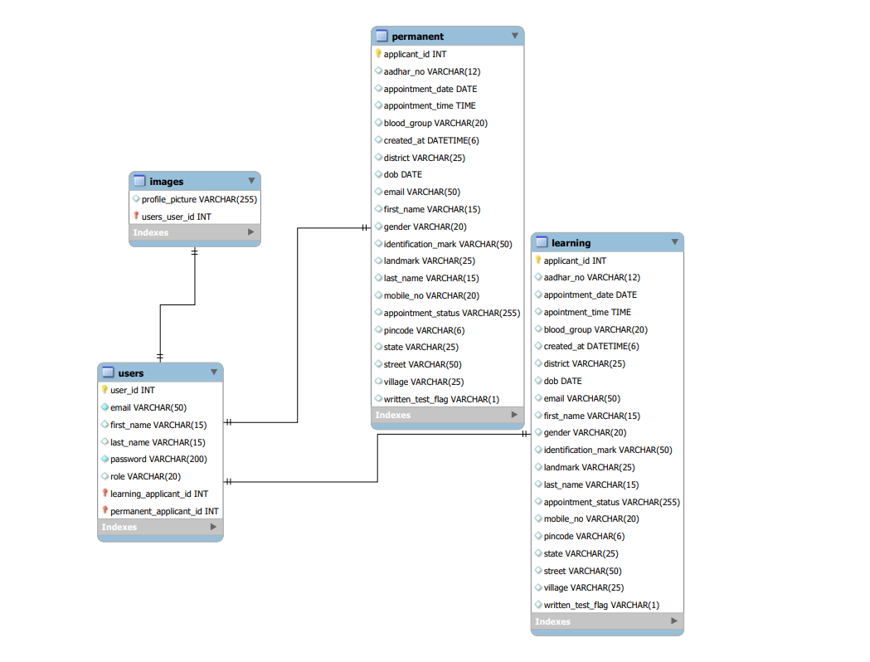
ER Diagram

Slide 15
SCREENSHOTS

Slide 16
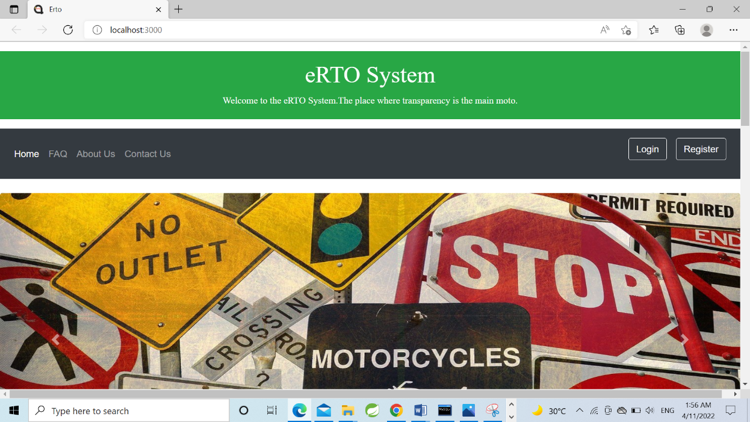

Slide 17
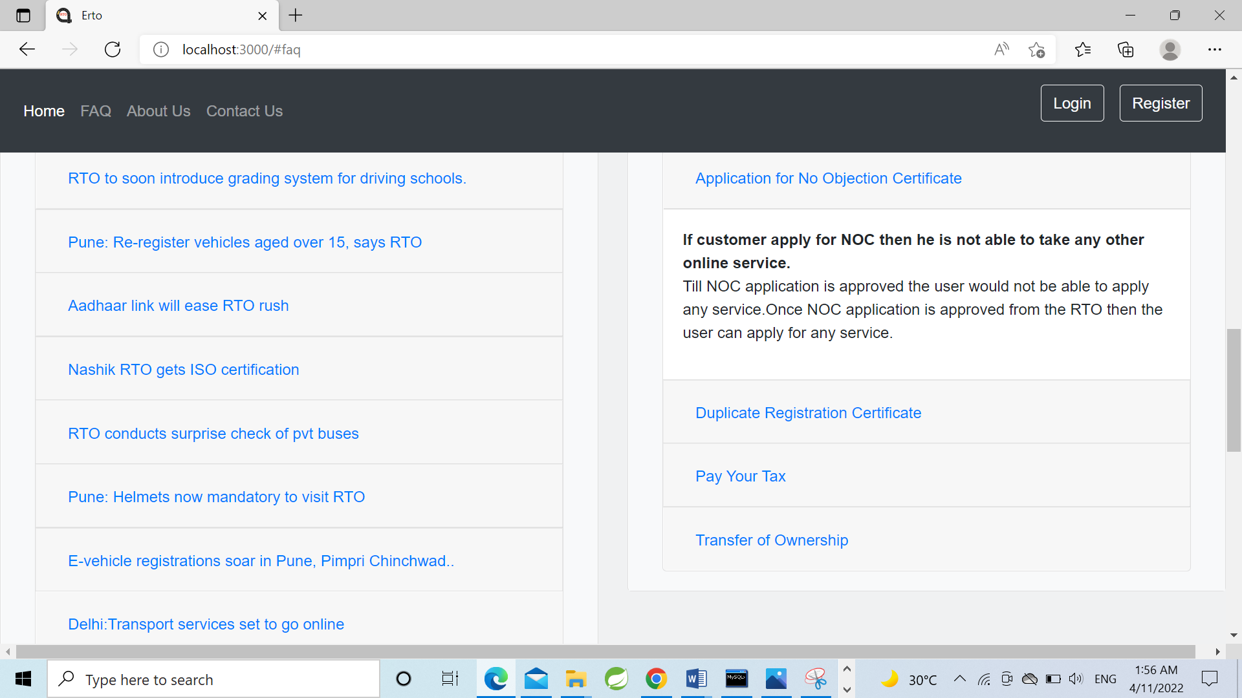
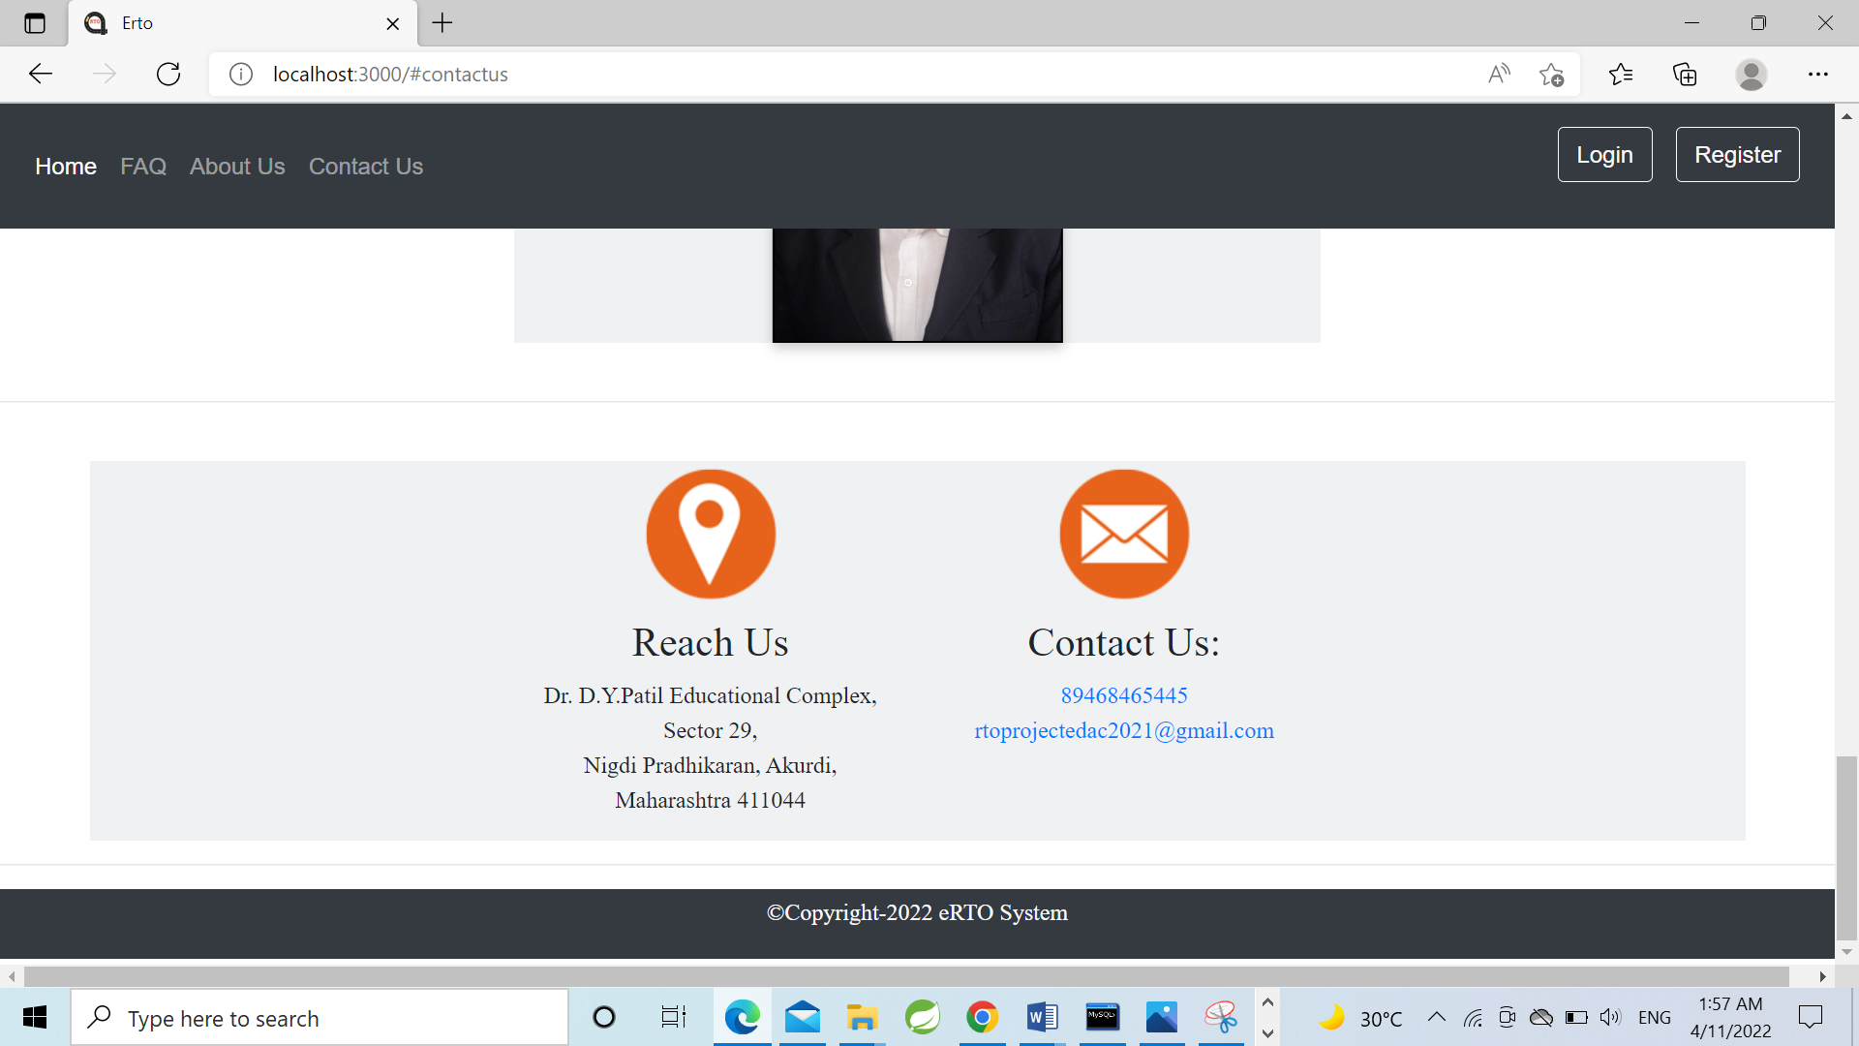

Slide 18
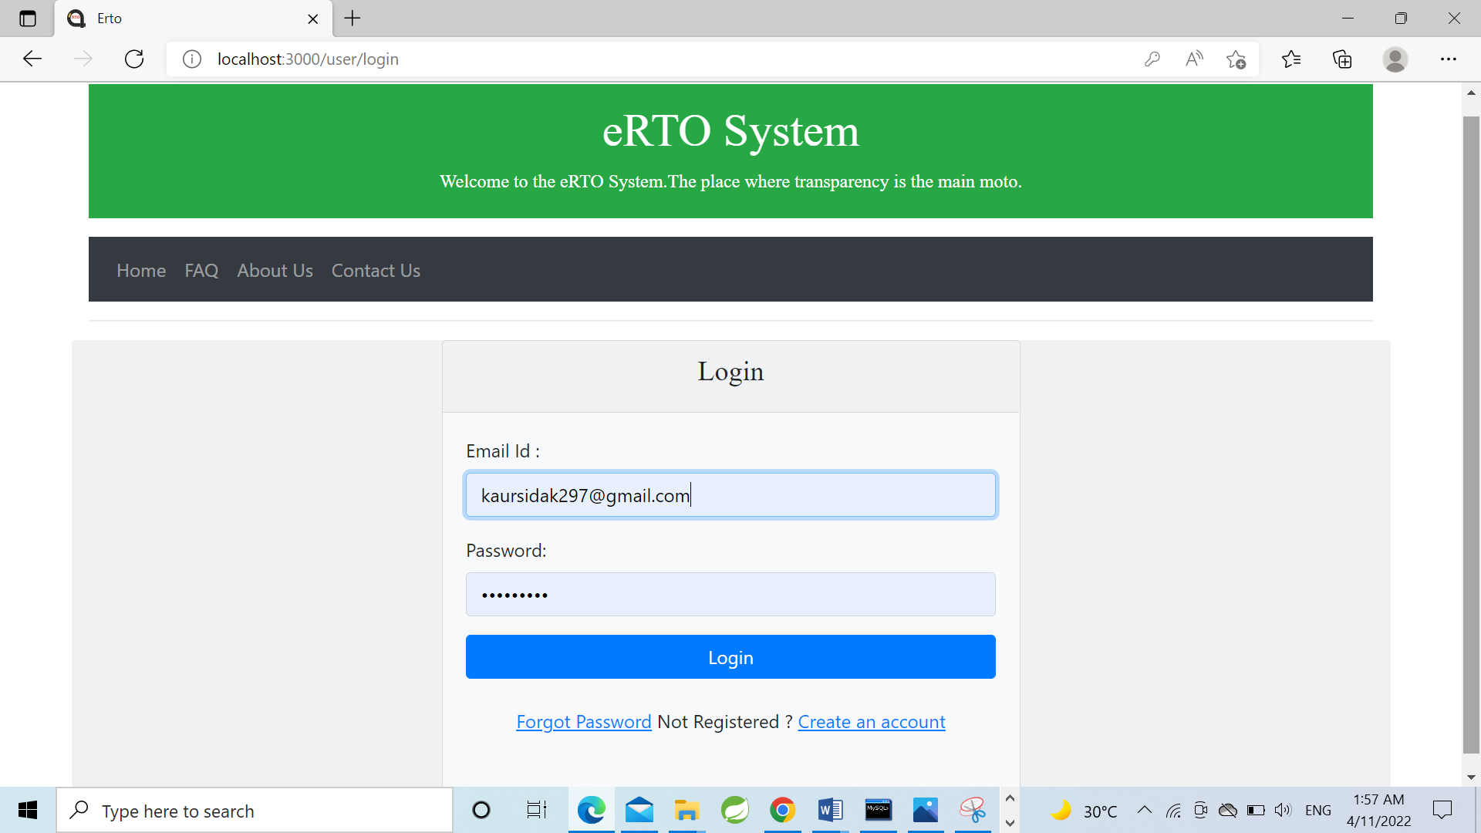

Slide 19
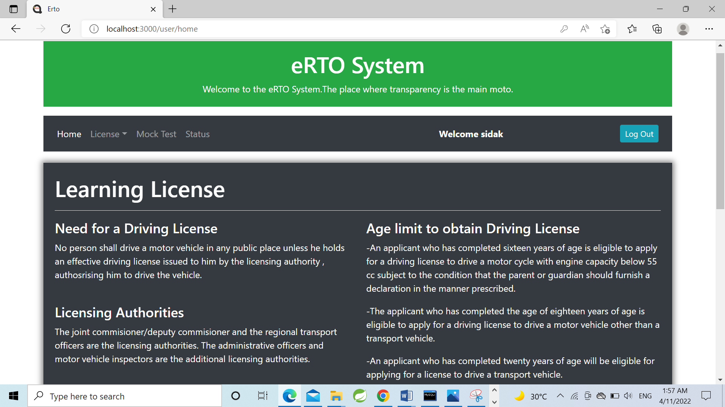
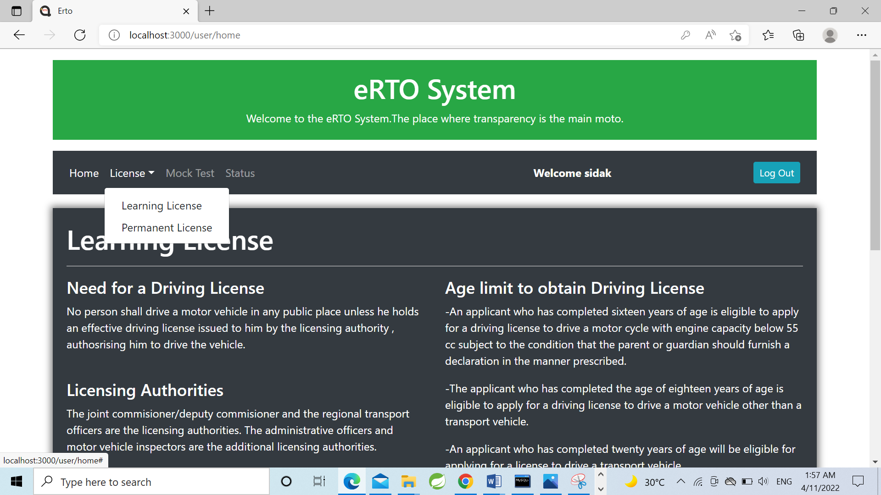

Slide 20
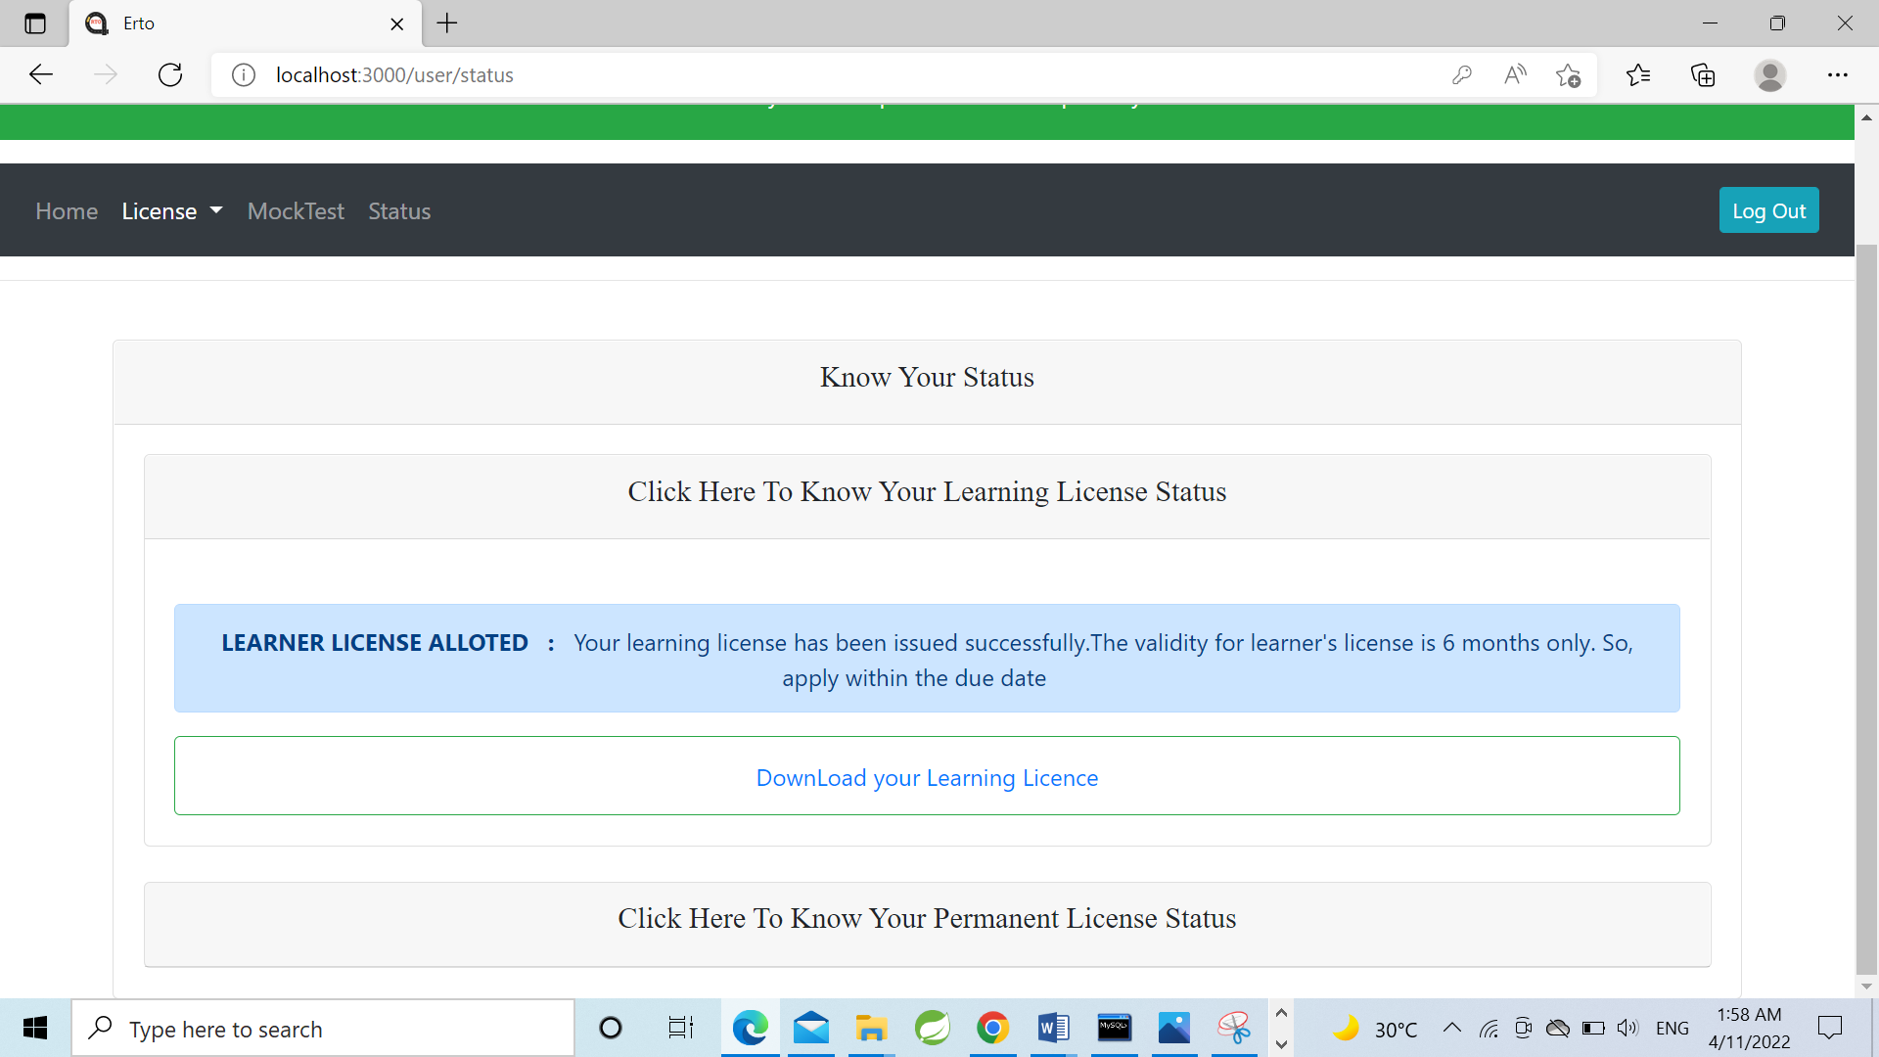
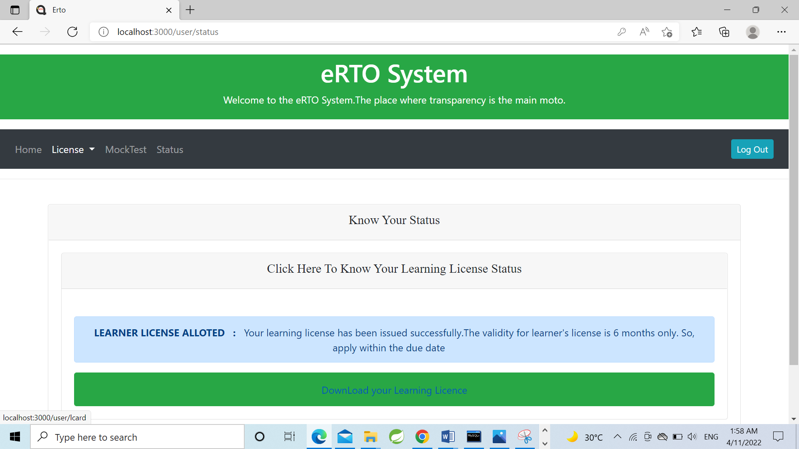

Slide 21
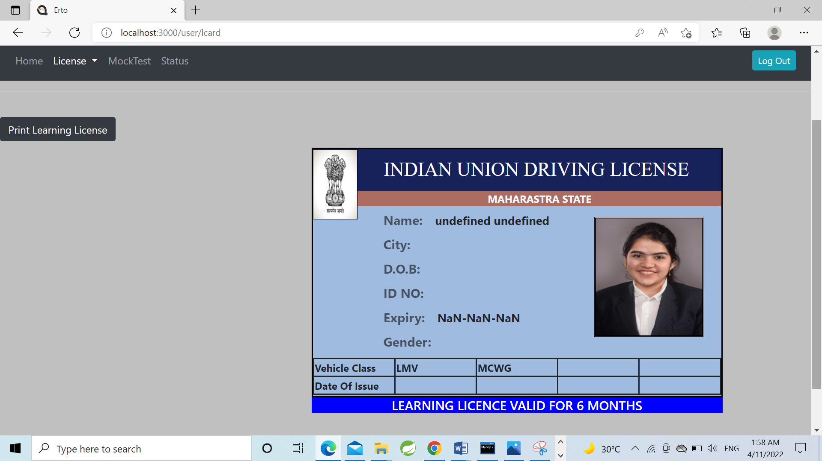
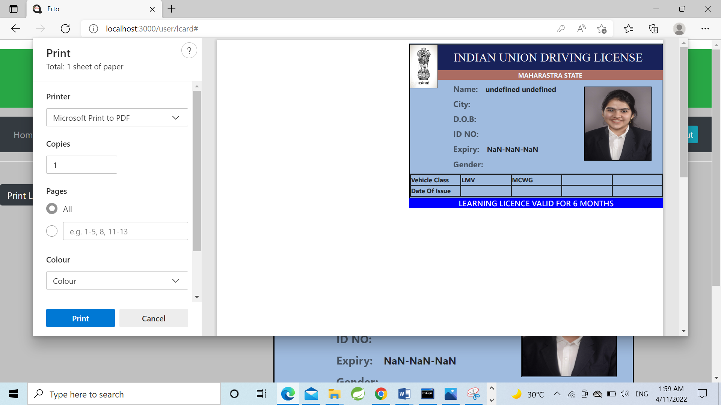

Slide 22
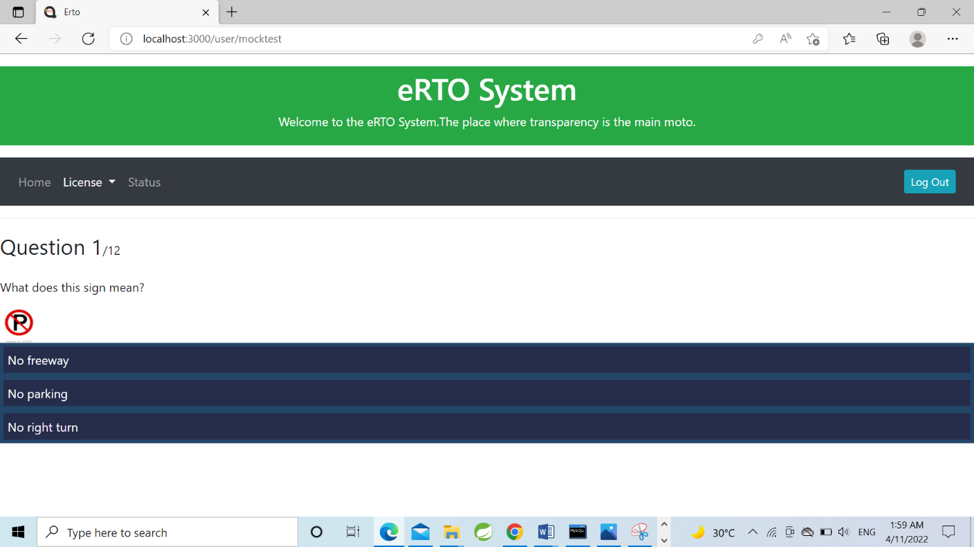
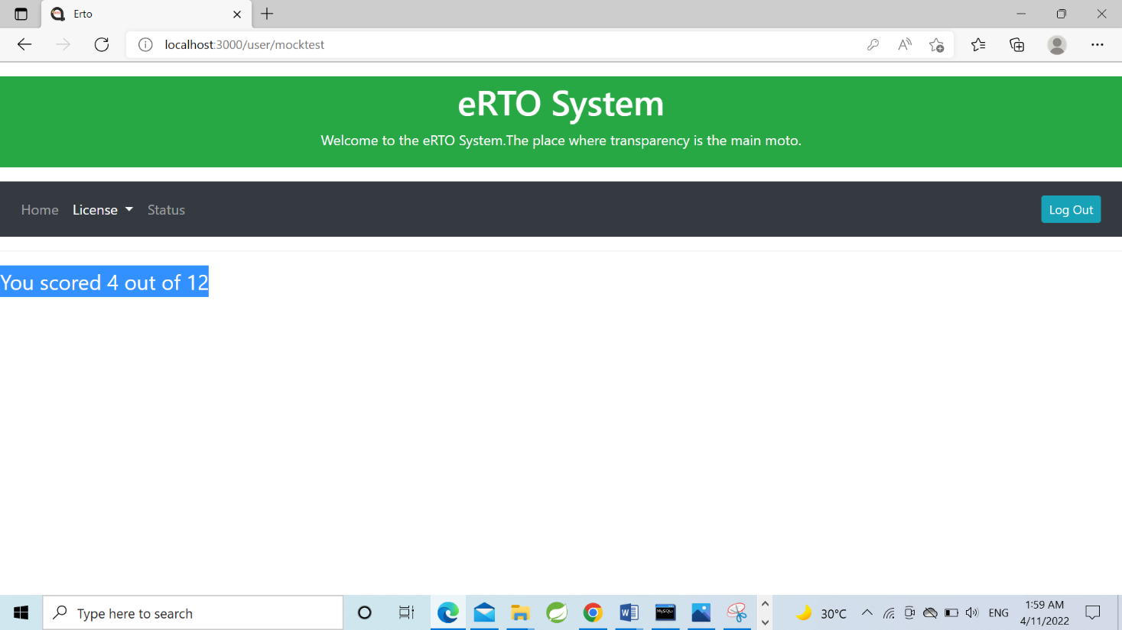

Slide 23
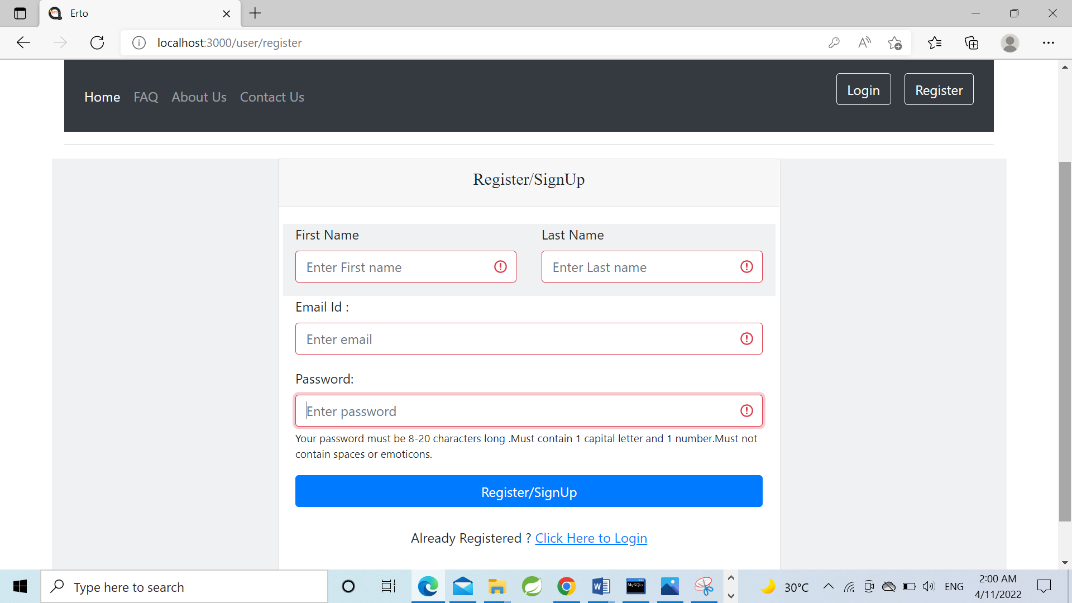
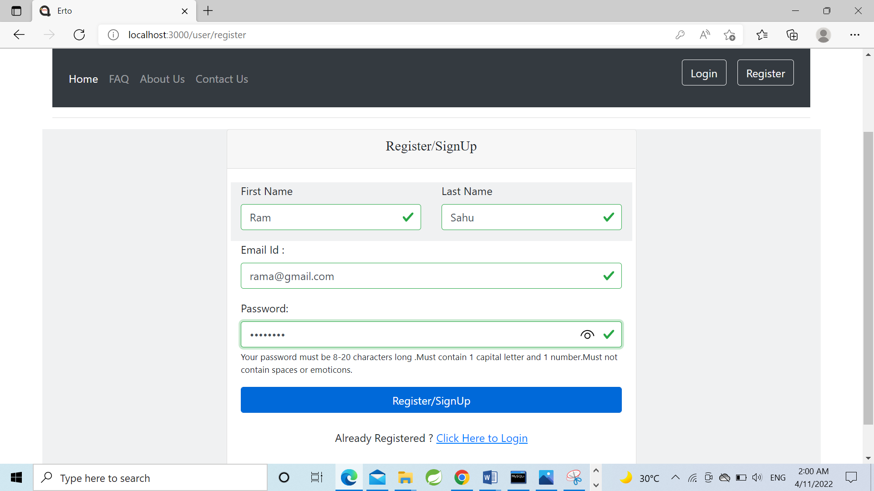

Slide 24
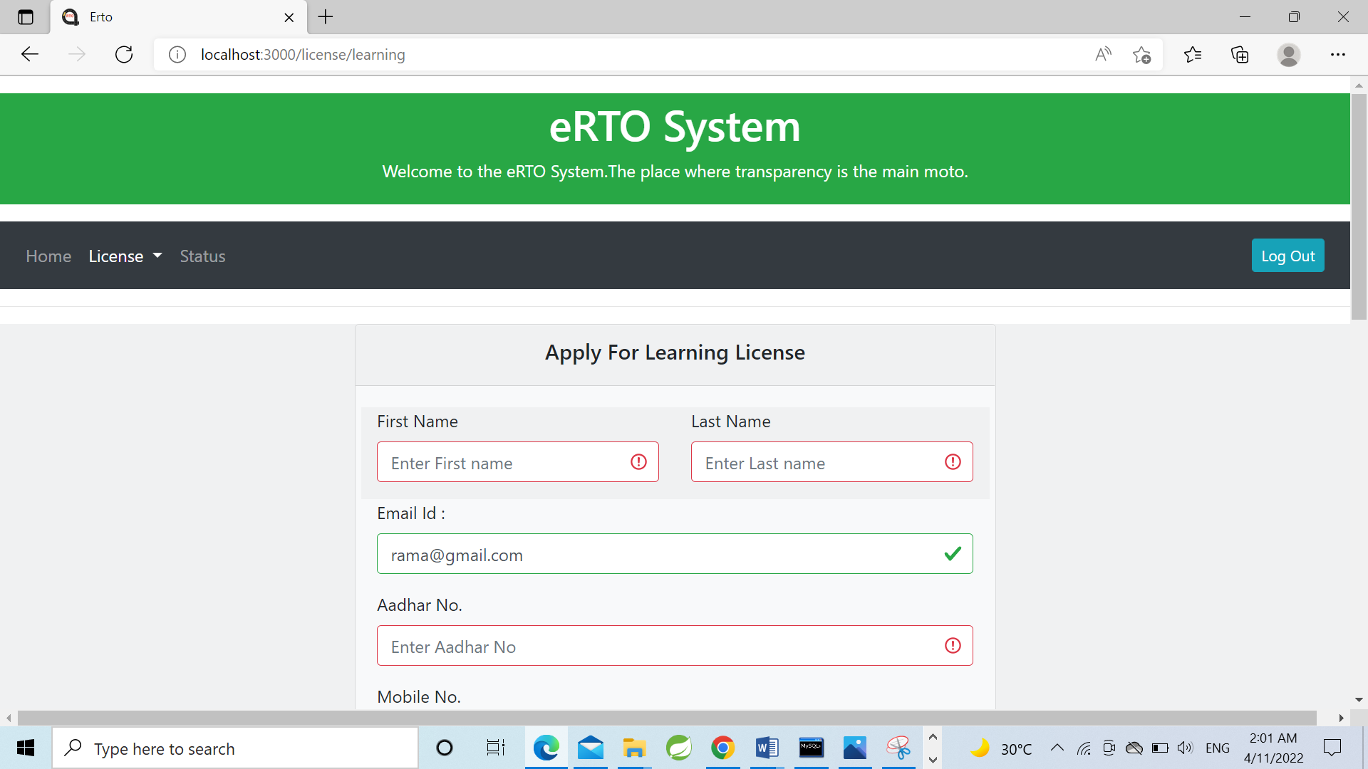
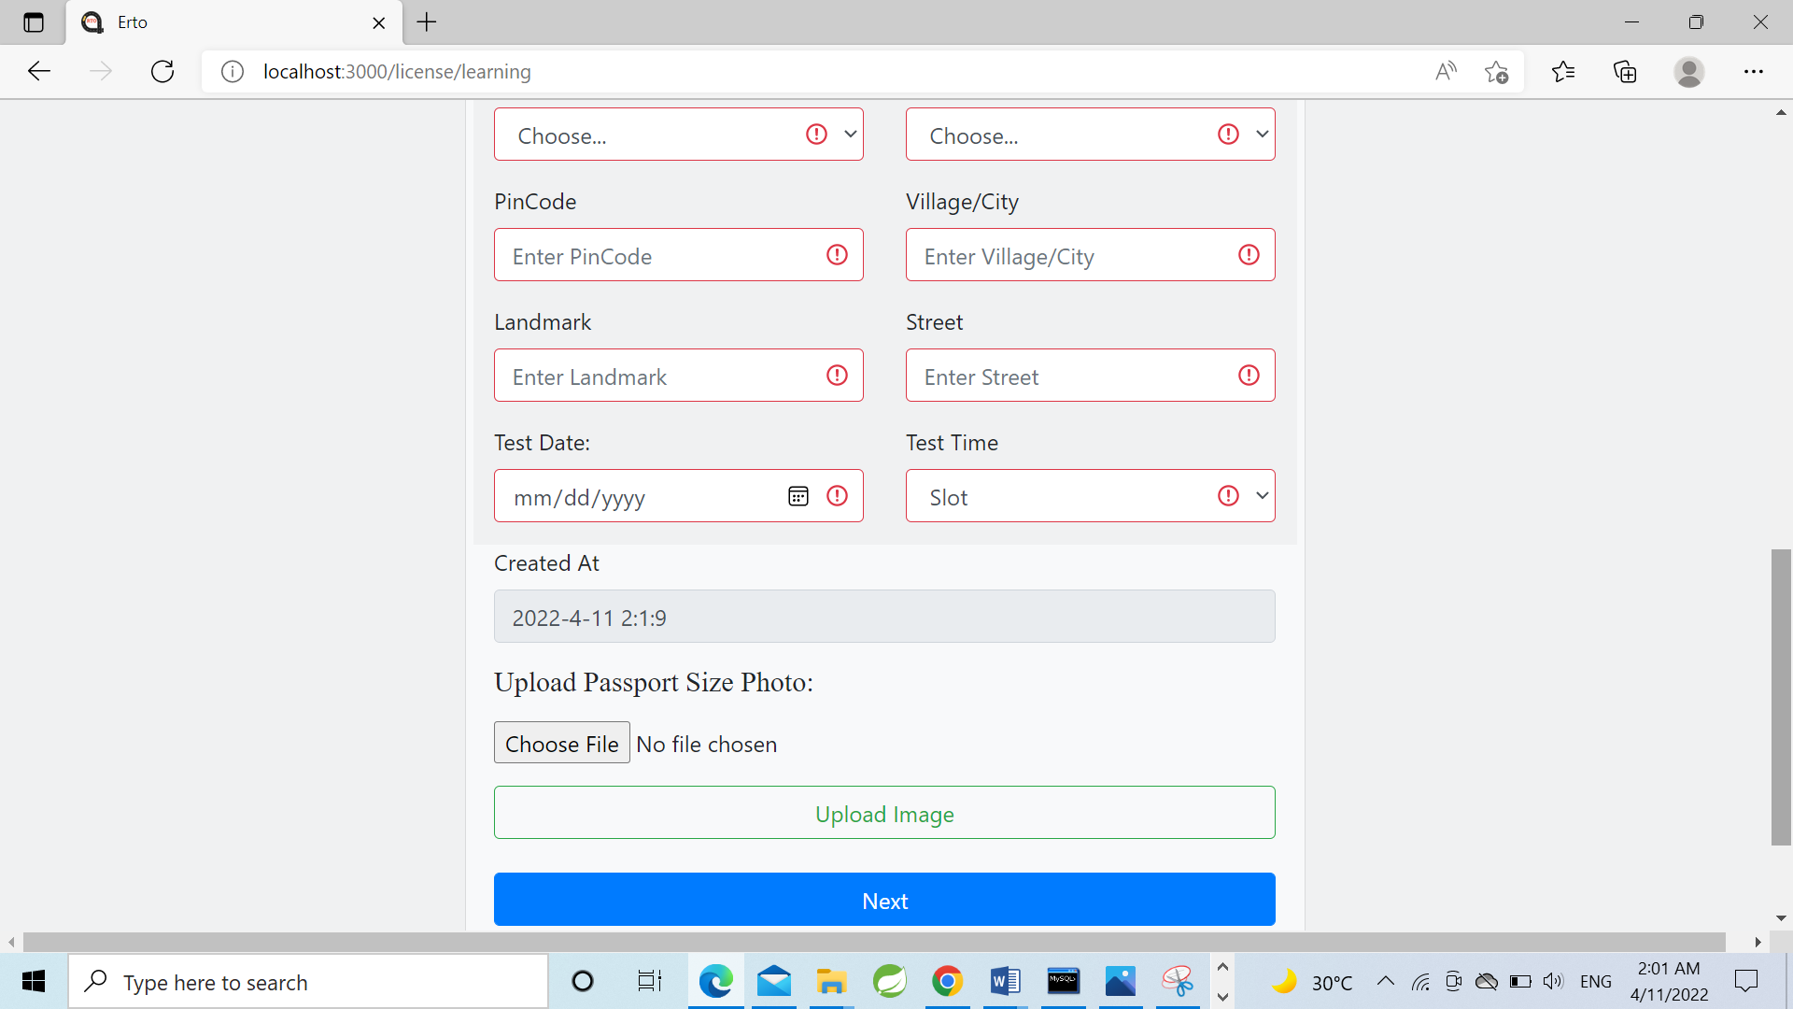

Slide 25
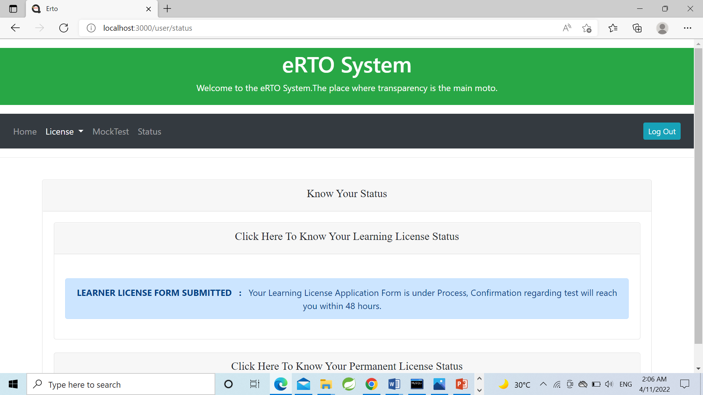

Slide 26
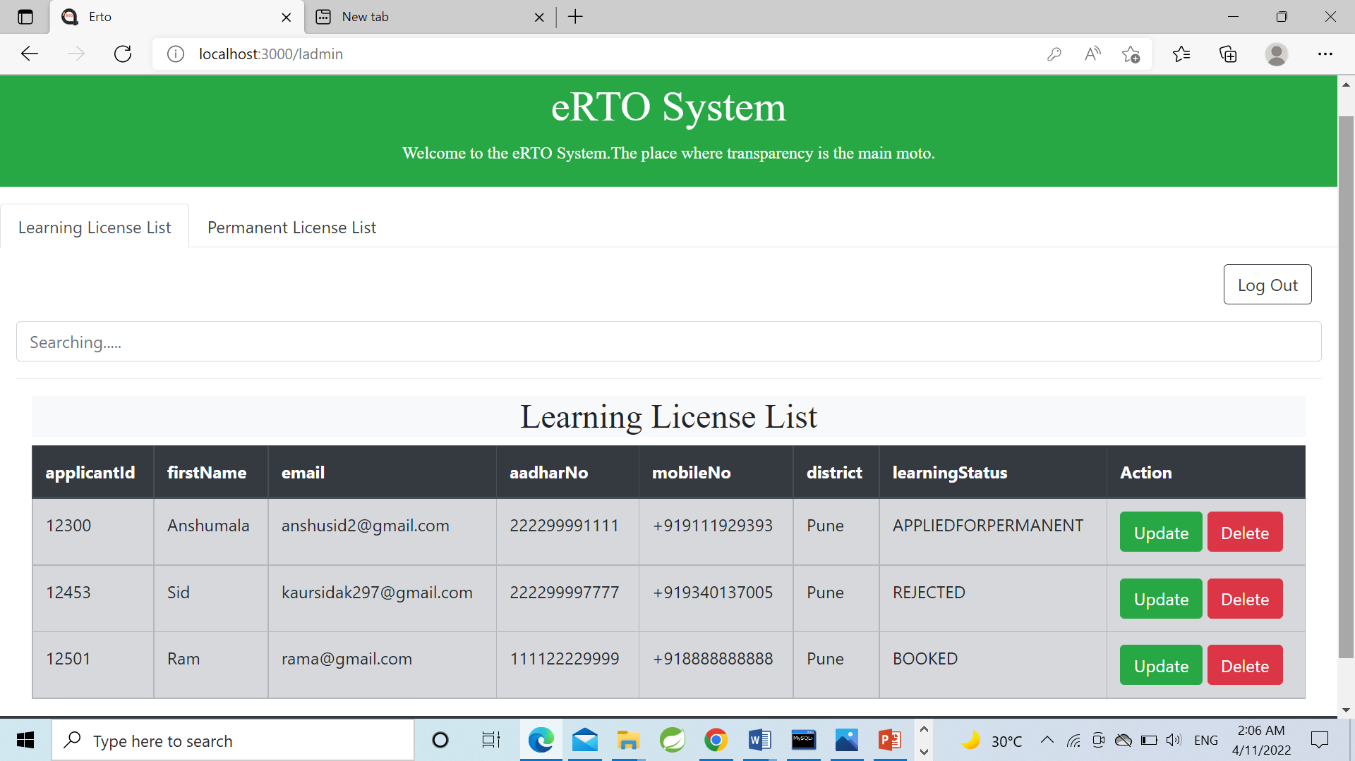

Slide 27
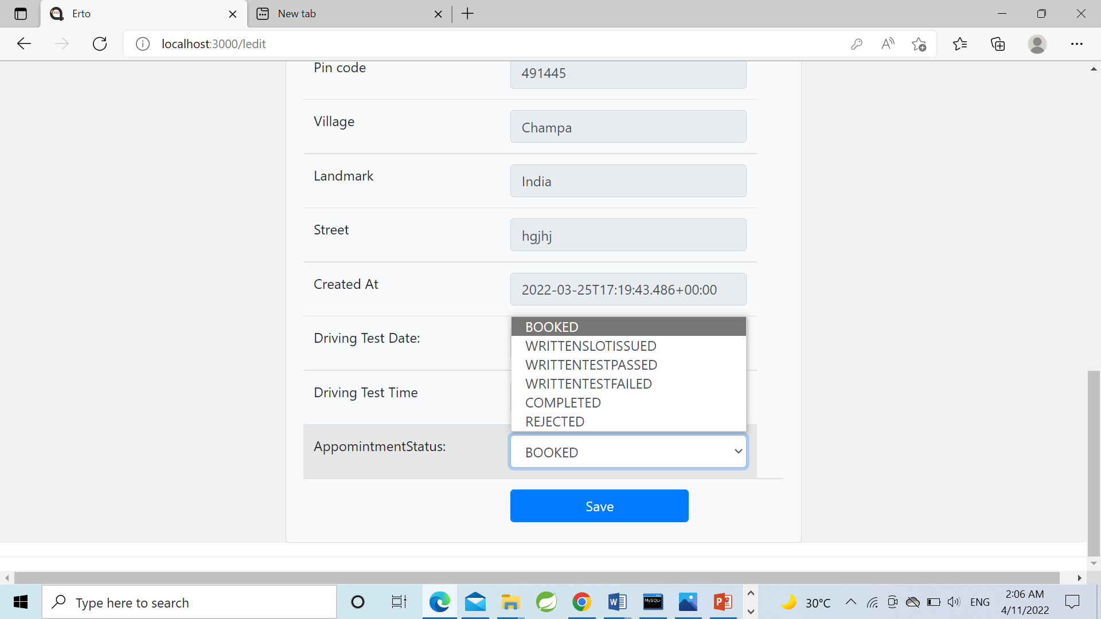
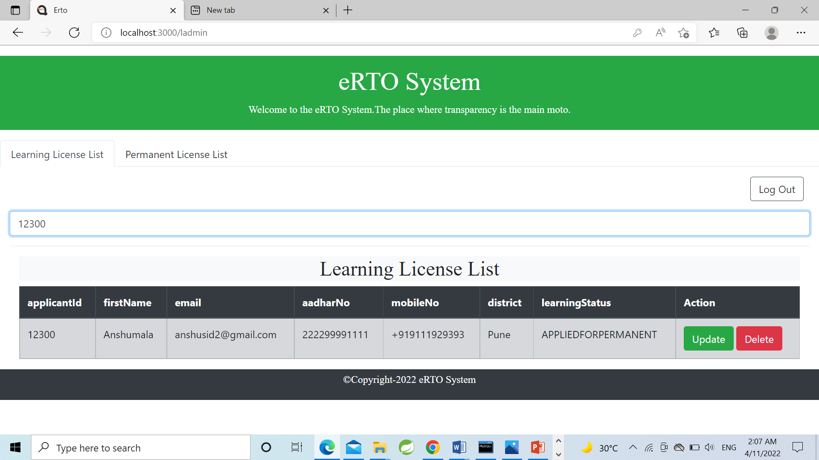

Slide 28
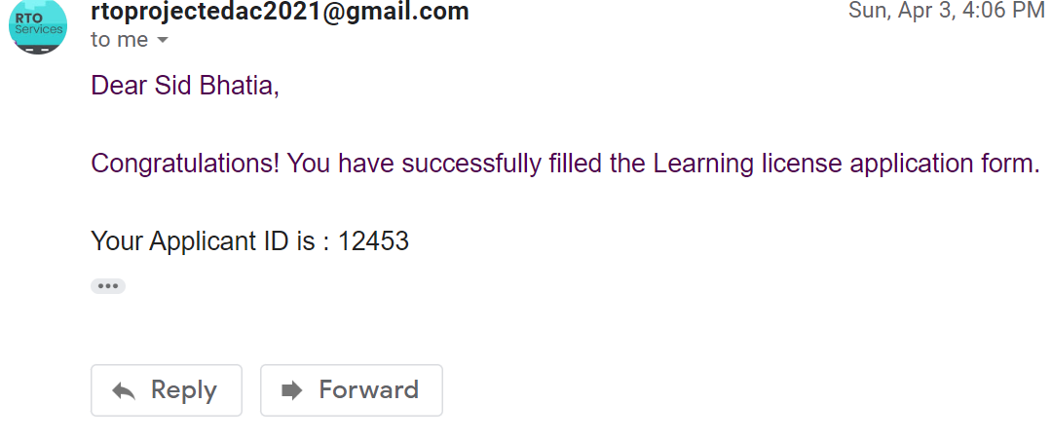
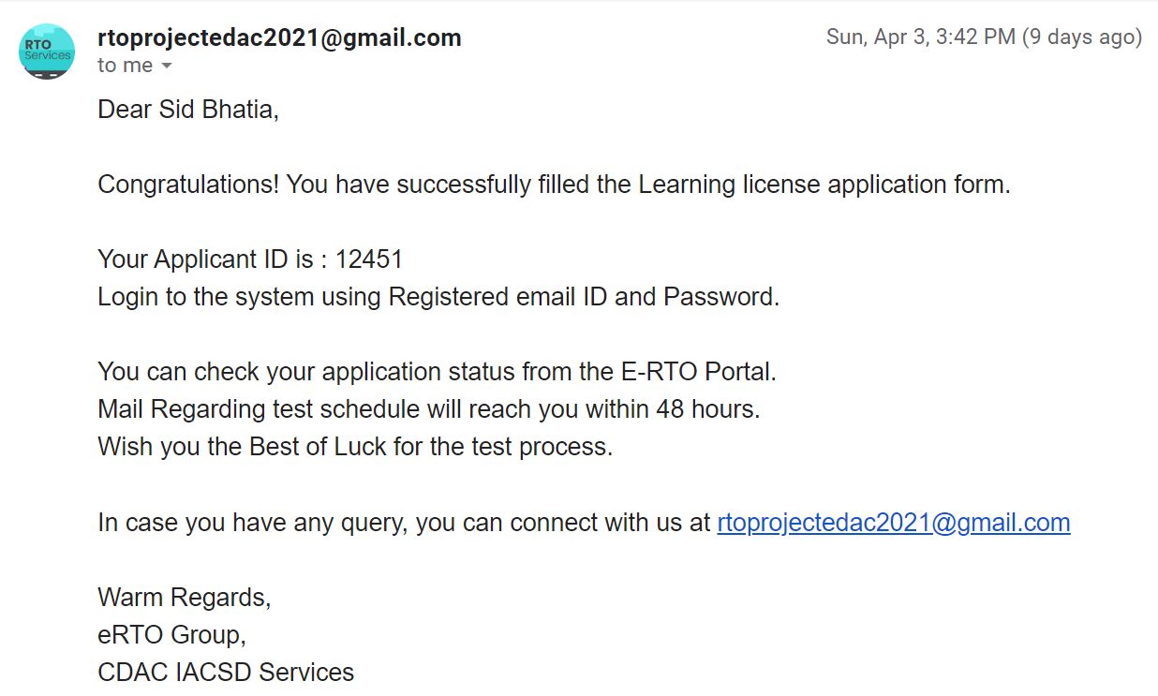

Slide 29
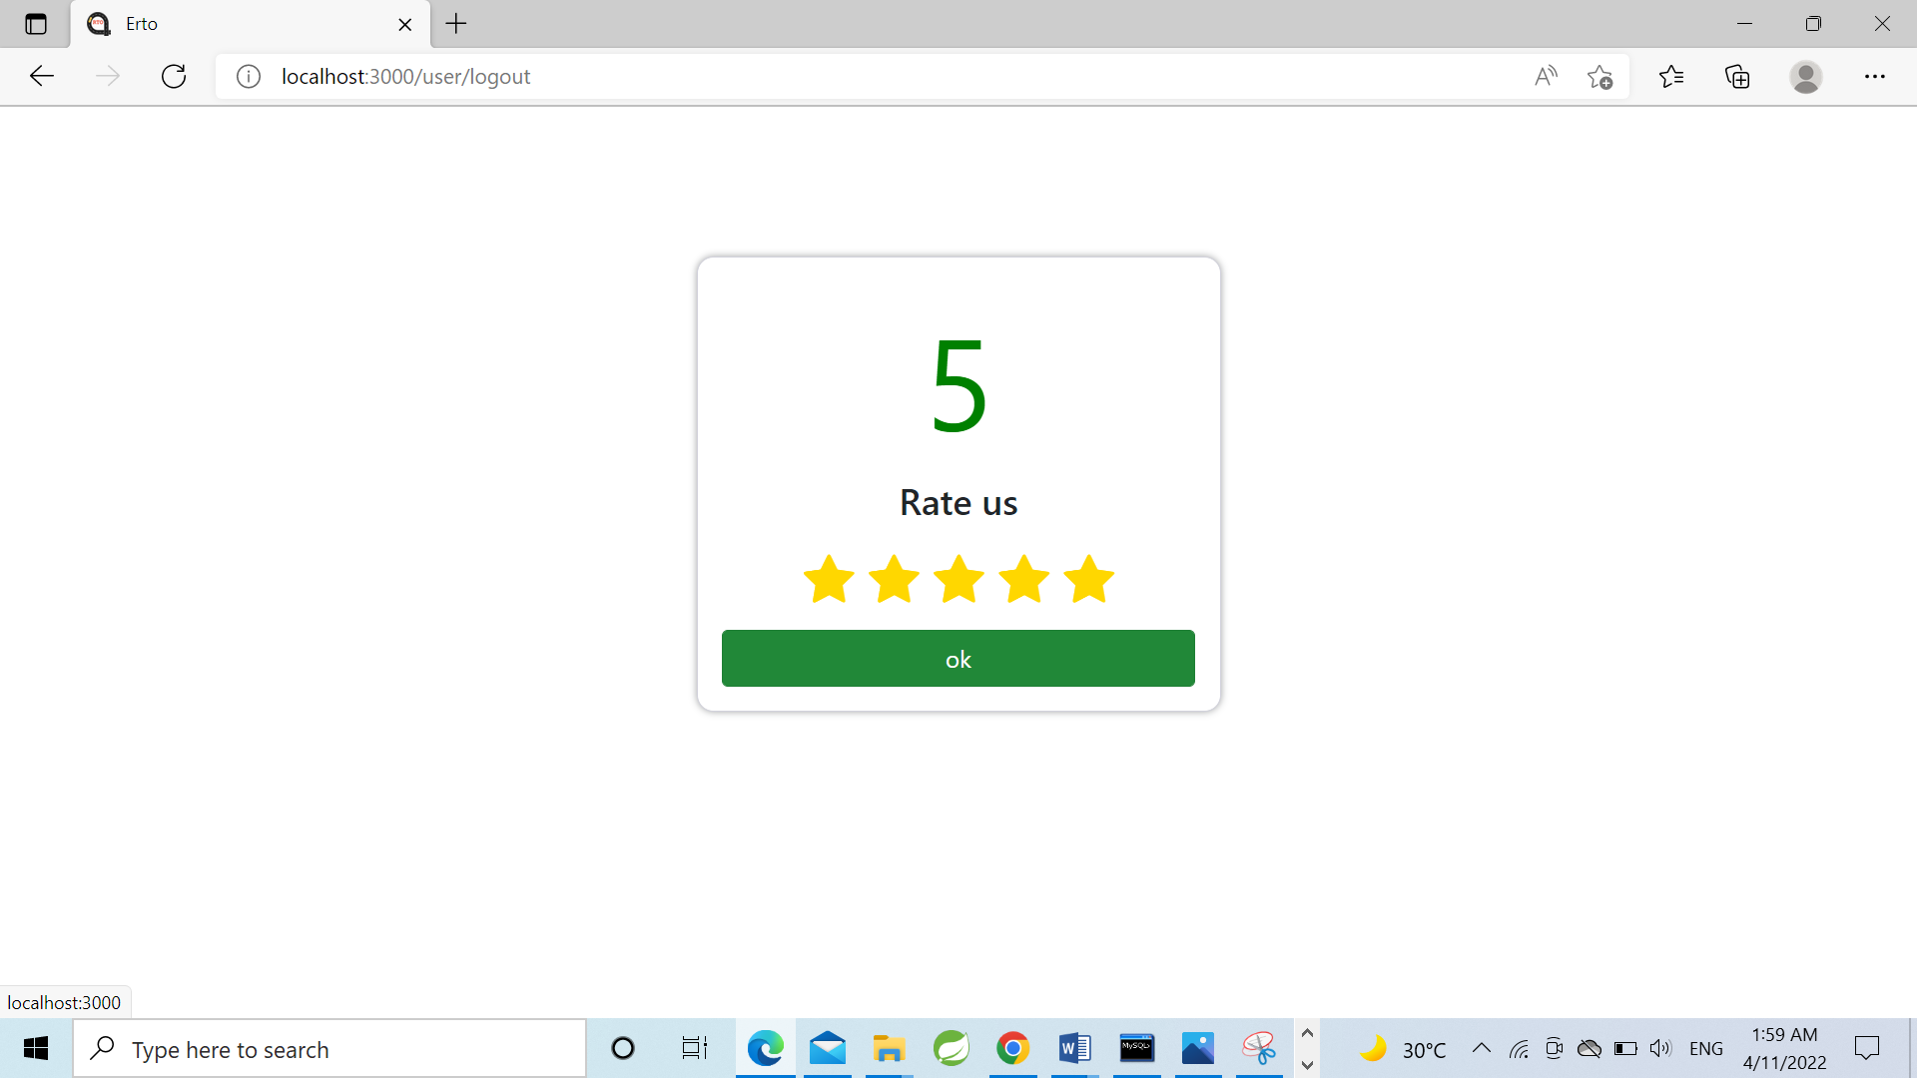

Slide 30
Specification
The application will use React Js, jQuery and CSS as main web technologies. HTTP and FTP protocols are used as communication protocols. SMTP protocol is used for Email communication.
Several types of validations make the web application a secured one and SQL injections can also be prevented.
Since E-RTO System is a web-based application , internet connection must be established.
The E-RTO System will be used on PC’s and will function via internet
Or intranet in any web browser.

Slide 31
S/W and H/W Requirements
Server Side:-
Processor: Intel® Xeon® processor 3500 series
HDD: Minimum 500GB Disk Space
RAM: Minimum 4GB
OS: Windows 10
Database: MySQL
Client Side(minimum requirement):-
Processor: Intel Dual Core
HDD: Minimum 80GB Disk Space
RAM: Minimum 2GB
OS: Windows 7

Slide 32
Advantages
Managing information.
Effortless Communication.
Lesser time requirement to maintain and manage records.
Paper work is reduced due to record stored in database.
All requirements at one platform.

Slide 33
Conclusion
The system generated only a limited number of reports. If more detailed reports are required the system can be directed Even though the system has well communication facility, it’s not enough.
The mail service can be enhanced with features bcc, cc etc. The system has full security but the account information for the customer credit information.
Improved communication, ease of access to RTO resources such as Registration forms etc, will help foster a stronger user relationship.
e - RTO management will empower you to spend more time and effort developing your users’ lifelong learning license.
In this e-RTO management complete global Module. (Any Where Any Time)
In this system the main entity is Admin who has all the right.
Here the main tasks of admin are update/delete registration, license.

Slide 34
Future Scope
This project can be enhanced further by adding some more features. The application is design in such a way that any further enhancements can be done with ease. The system has the capability for easy integration with other systems. New modules can be added to the existing system with less effort. In future a new function or procedure can be easily added in the system through these classes. Or even a new class can be added.
The software is flexible enough to be modified and implemented as per future requirements. We have tried our best to present this free and user–friendly website to Regional Offices.

Slide 35
References
React Tutorial (w3schools.com)
Learn Spring Boot | Baeldung
Spring Data JPA - Reference Documentation
React – A JavaScript library for building user interfaces (reactjs.org)
Bootstrap · the most popular HTML, CSS, and JS library in the world. (getbootstrap.com)

Slide 36

9340137005
9584229449
kaursidak297@gmail.com
ani.121jai@gmail.com

